Slide 1

Fine-Tuning LLMs on Text-to-SQL Generation
Rama Chandra Kashyap Mamidipalli
002852095
Using Gretel's Synthetic Dataset | LLaMA 3 & DeepSeek-R1:8B

Slide 2

Dataset And Models
Dataset: GretelAI's Synthetic Text-to-SQL
Models:
LLaMA3 : 8B
DeepSeek-R1:8B

Slide 3

Problem Statement
Convert natural language queries into SQL
Improve SQL generation accuracy using fine-tuned LLMs
Compare performance before and after fine-tuning

Slide 4
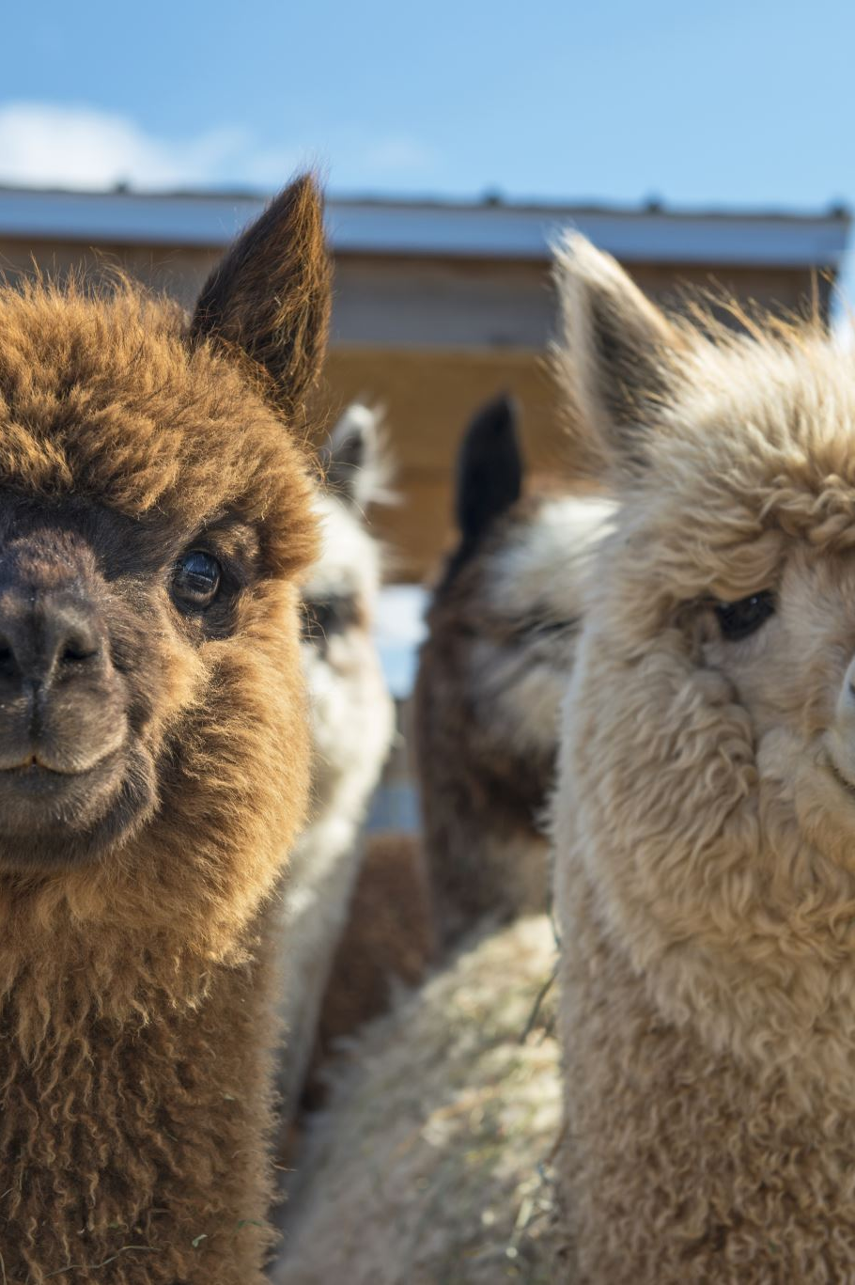
Deepseek and LLama
Models: LLaMA 3 & DeepSeek-R1:8B
Optimized for SQL generation using Ollama framework

Slide 5


Fine-Tuning Architecture
GretelAI Dataset
Tokenization (Unsloth FastLM)
Model Selection (Deepseek Llama)
{
“SQL Prompt”, “SQL” , “Explanation”
}
“Target Modules: Attention Layers”, “Optimizer: AdamW_8bit” ,
“Batch Size: 2 ”,
“Learning Rate: 2e-4 ”
Model Evaluation (Accuracy & Time)
Fine-Tuning (LoRA SFT)
Creating GGUF (GPT-Generated Unified Format)

Slide 6
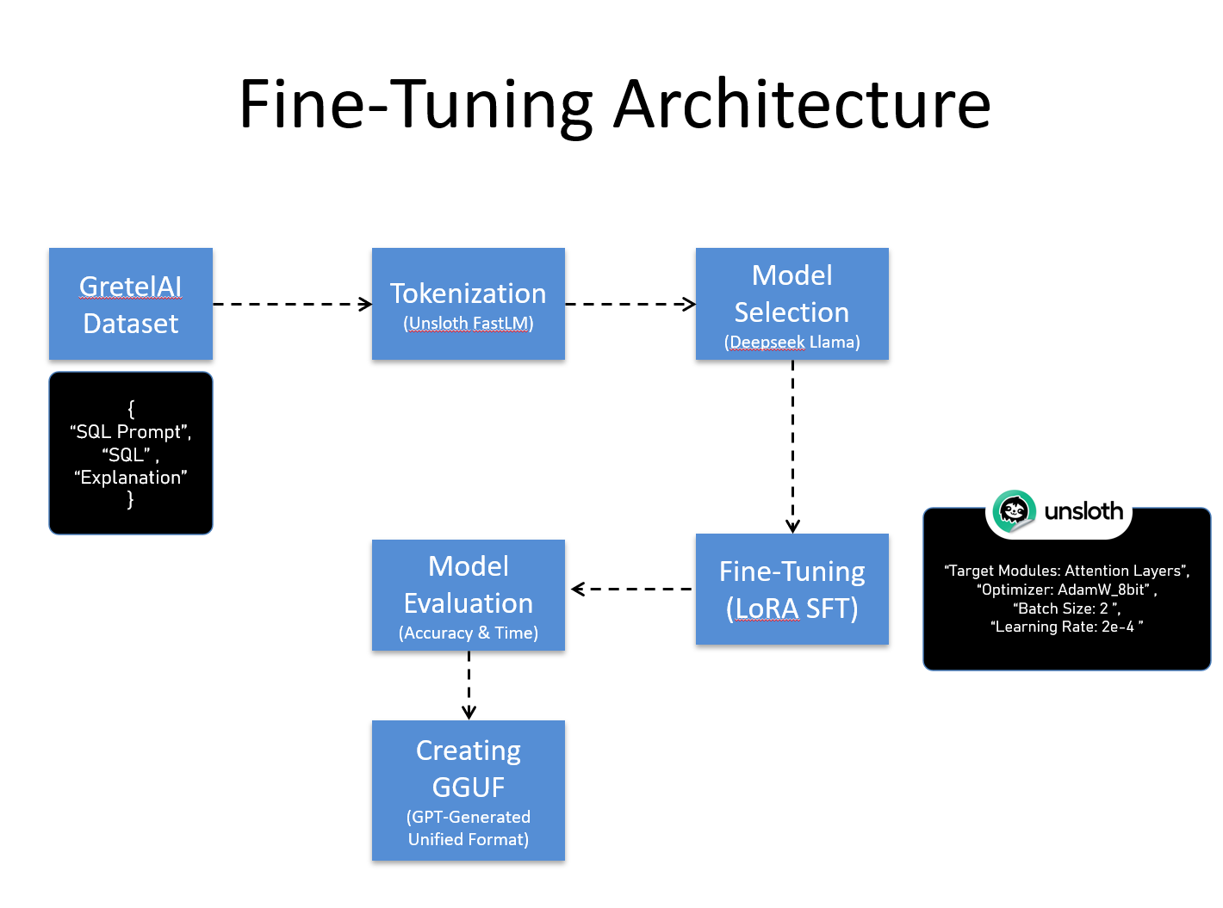


Complete Architecture
Convert the GGUF file to the Ollama extract
Create New Model (Finetuned Models)
Run models in Ollama API
API Calls for Each model (2 Base & 2 finetuned)
User Interface using Streamlit

Slide 7
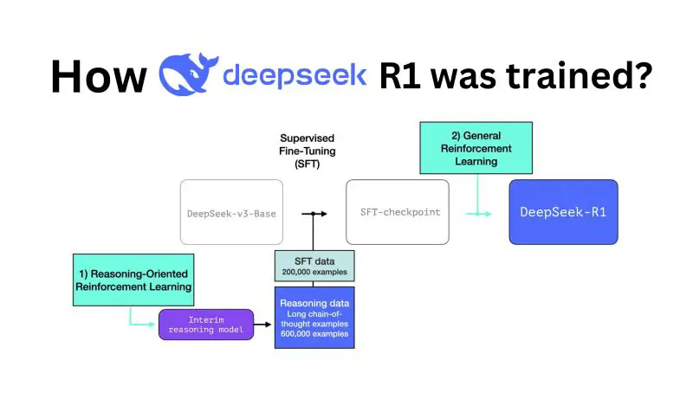
Fine-Tuning DeepSeek using Unsloth
Used Unsloth’s FastLanguageModel for efficient training
Applied 4-bit quantization for memory efficiency
LoRA fine-tuning with target layers: q_proj, k_proj, v_proj, etc.
Training optimized with gradient checkpointing and AdamW_8bit

Slide 8
GGUF –GPT generated Unified Model
GGUF makes LLMs more compact and faster to load.
This is crucial for local deployment, where storage space and RAM might be limited
compared to cloud environments.
The format uses advanced compression techniques to reduce model size without
sacrificing performance.
The Role of llama.cpp
It's the reference implementation for running GGUF models, setting the standard for
how these models should be processed and executed.
llama.cpp pioneered techniques for running large models on consumer hardware,
including quantization methods that reduce model size and memory requirements
without significant loss in quality.

Slide 9
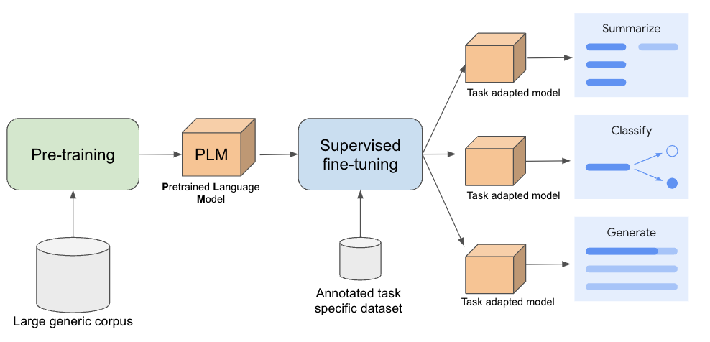
Supervised Fine-Tuning Approach

Slide 10
Data Preprocessing
Converted dataset into instruction-response format
Prompt: Natural language query
Response: SQL query
Saved in JSONL format for compatibility

Slide 11
Evaluation Metrics
Execution Time: Measures response speed
Accuracy: Comparison with ground truth SQL queries
Response Time Distribution: Performance variation across models
Model | Accuracy (Before) | Accuracy (After) | Execution Time
DeepSeek-R1:8B | 85% | 95% | Moderate
LLaMA 3 | 90% | 92% | Faster

Slide 12
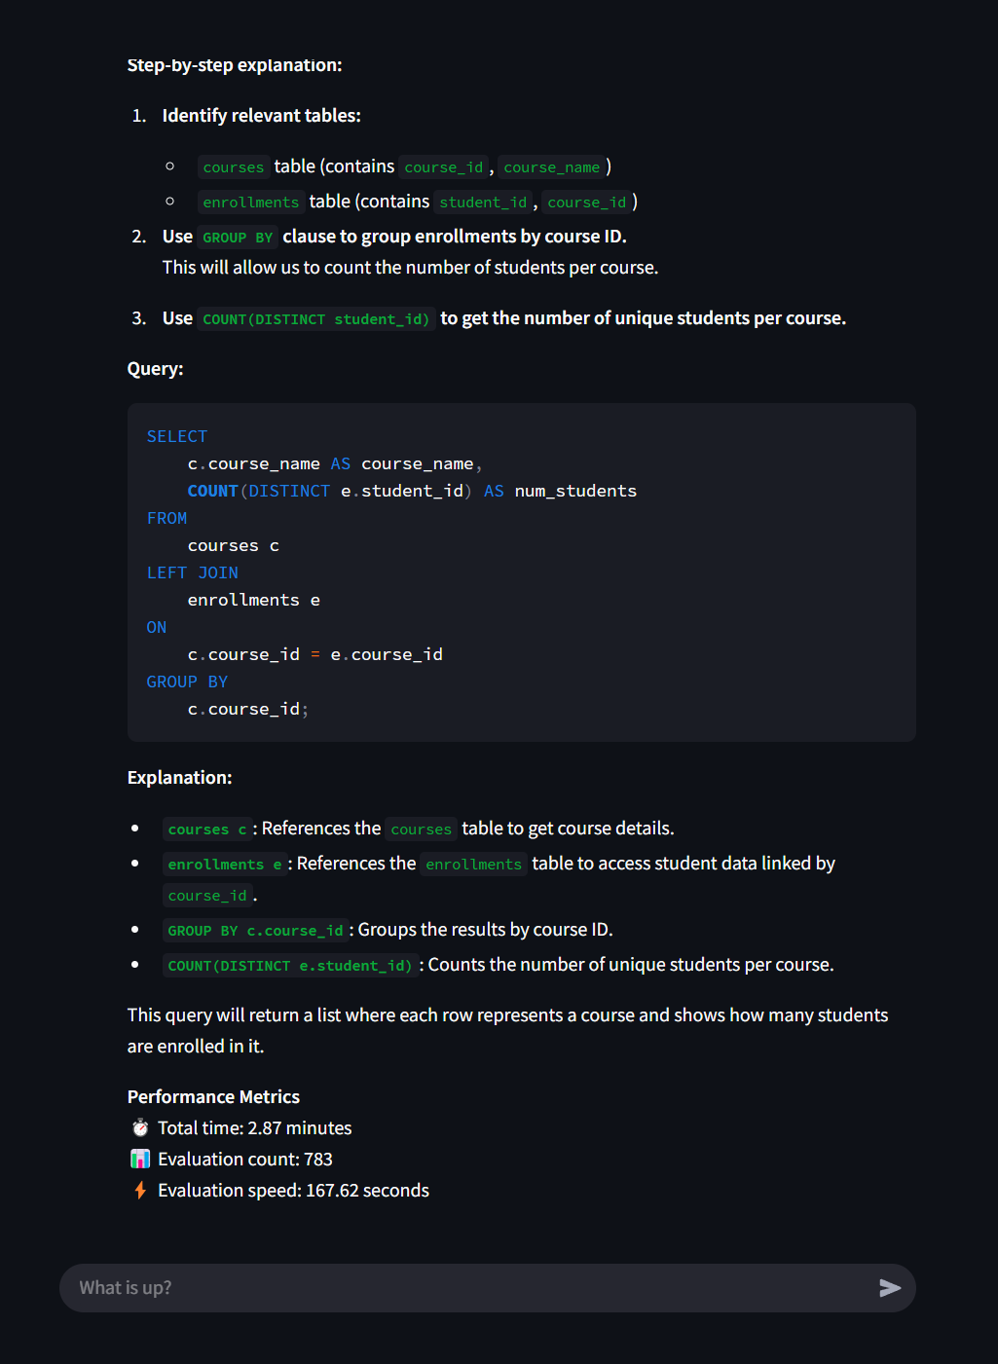
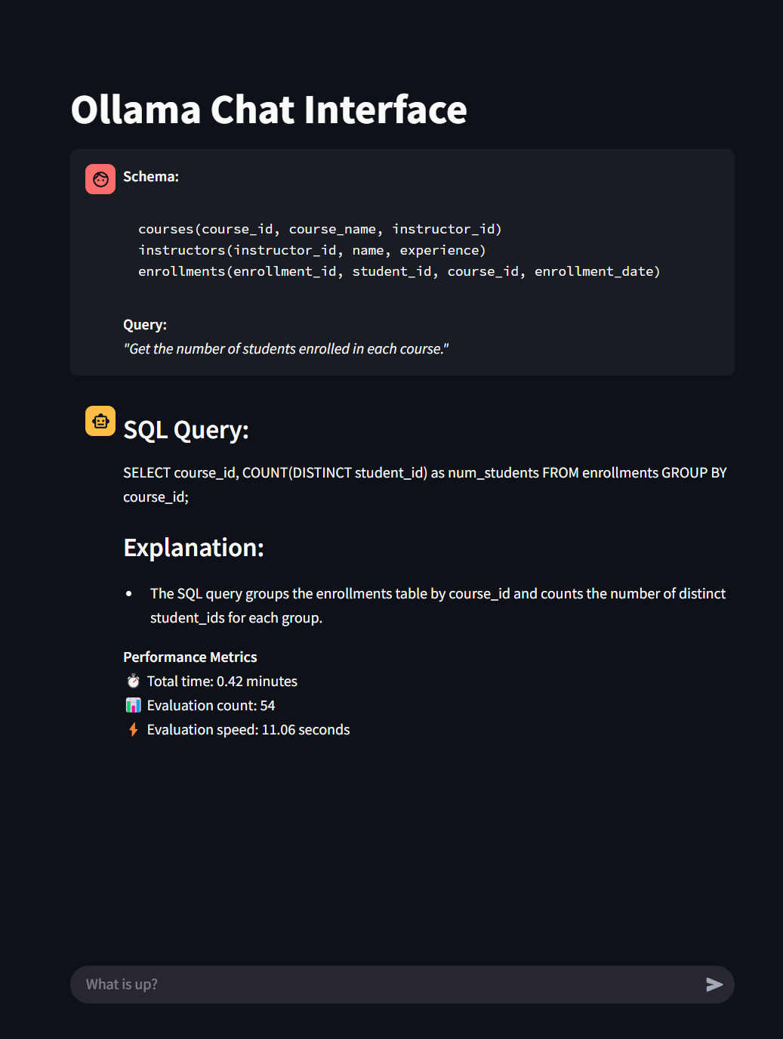
Performance Comparison of Deepseek and Finetuned Deepseek

Slide 13
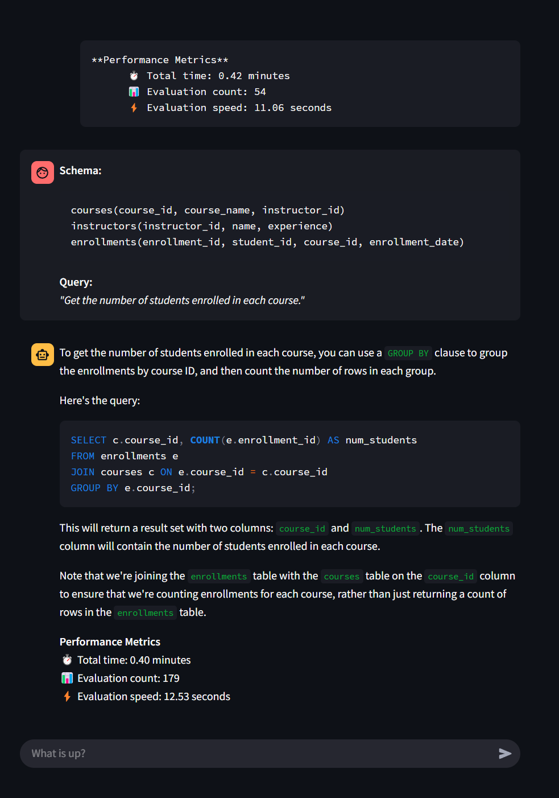
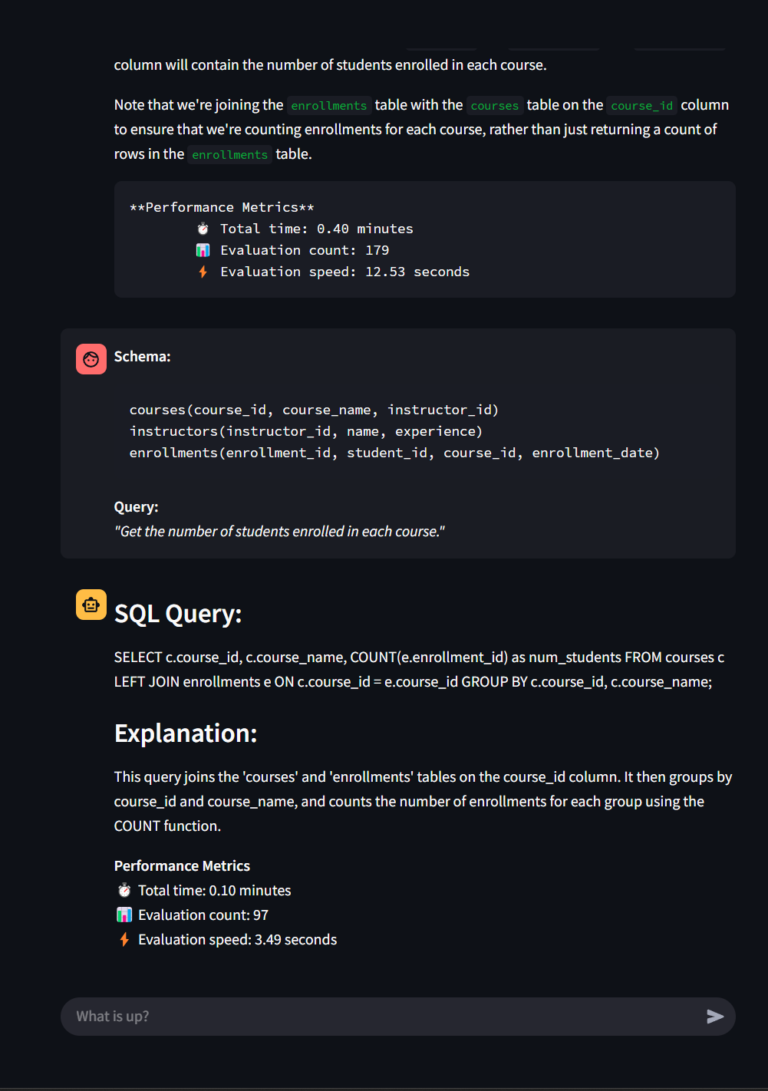
Performance Comparison of Llama and Finetuned LLaMa

Slide 14
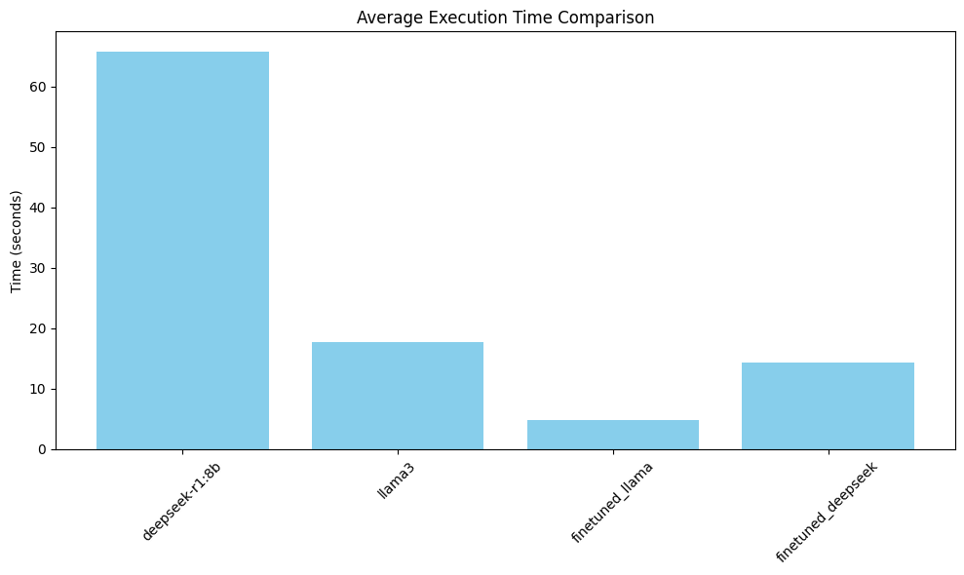
Pre-Fine-Tuning Performance
DeepSeek-R1:8B: 85% accuracy
LLaMA 3: 90% accuracy
Execution times varied across queries

Slide 15
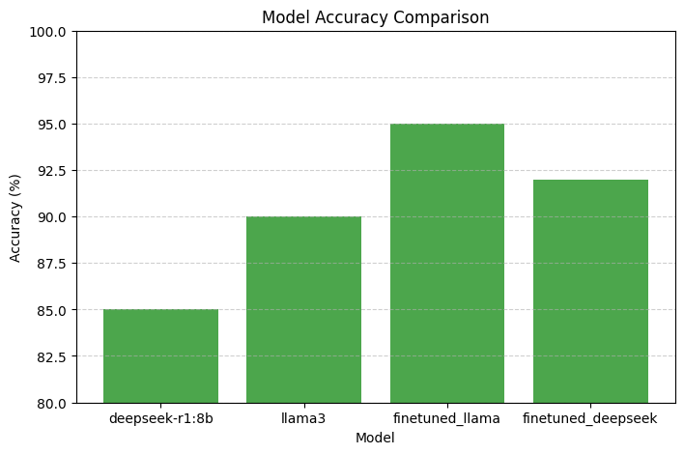
Post-Fine-Tuning Performance
- DeepSeek-R1:8B: 95% accuracy
- LLaMA 3: 92% accuracy
- Faster SQL generation after tuning

Slide 16
Challenges & Observations
Some complex queries were incorrectly structured
Model biases in predicting table joins
Execution speed improved with optimized training

Slide 17
Conclusion
Fine-tuning significantly improved SQL accuracy
Execution speed was optimized
Future work: Extend fine-tuning to other SQL domains

Slide 18
Thank You!

